Slide 1
Programming vocabulary

Slide 2
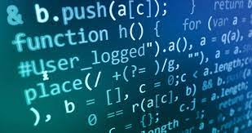
algorithm
Input: This is the data set that the algorithm needs as input to process.
Process: These are the necessary steps applied by the algorithm to the input received in order to arrive at an output or resolution of the problem.
Output: The result produced by the algorithm from the processing of the input once the process is finished.

Slide 3
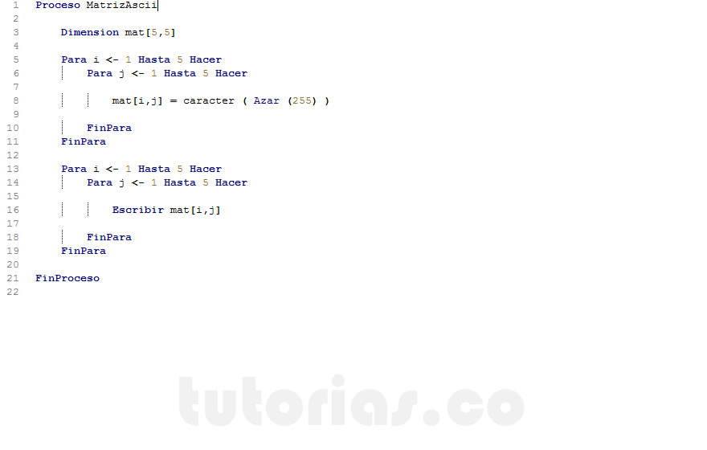
Array
To work a char array looks like working with a vector, we must indicate a single subscript and we will be accessing the entire row.
we can store number names

Slide 4
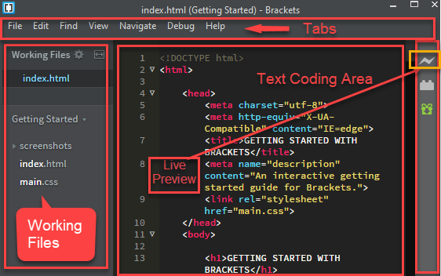
Brackets
Brackets is a lightweight, yet powerful, modern text editor. We blend visual tools into the editor so you get the right amount of help when you want it without getting in the way of your creative

Slide 5
assignment
let x = 2;
const y = 2;
is used to assign a value to a variable. The mapping operation evaluates the assigned value. You can chain the assignment operator to assign a single value to multiple variables

Slide 6
string
let string = 'This is my string’;
Understand that strings are objects and learn to use some of the basic methods available in those objects to manipulate strings.

Slide 7
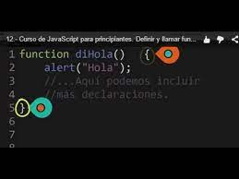
call
To perform this task, we will create an HTML link and we will use its href attribute to call the function in question. Unlike a traditional link where only the full URL is used to make a redirect in this case it is necessary to indicate that a function will be called

Slide 8
compiler
Software that trasnlates a program writhen in aa high level programming language compiler usually generates assembly language first and then assembly languaje into machine languaje a utility know as a linker

Slide 9
crash

